Slide 1
Analysis on Insurance dataset
Yash Titare

Slide 2
Problem Statement
Analyse the Insurance Dataset understand the patterns and provide the conclusion .
Key features :
1. Identify the relationships in dataset .
2. Analysis on charges .
3. Geographical region analysis.
4. Customer life value.
5. Other attributes

Slide 3
Proposed Solution
Data Preprocessing:
Explore the distributions and statistics of each column (age, bmi, children, charges).
Handle missing values, outliers in the dataset.
understand categorical variables (sex, region, smoker) .
2.Calculate Statistics:
Calculate and analyze statistics for numerical columns (mean, median, standard deviation, etc.).
Create visualizations (histograms, box plots) to understand the distribution of age, bmi, children, and charges.

Slide 4
3.Correlation Analysis:
Explore correlations between variables, especially between smoking status and charges.
Visualize correlations using heatmaps to identify potential relationships.
Relation between :
Age - Smoker
region - Smoker
region - Charges
Smokers - Charges
4. This conclusion to provided dataset to extract valuable insights for insurance dataset.

Slide 5
Effect of Data Preprocessing
Data preprocessing transforms the data into a format that is more easily and effectively processed in data mining, machine learning and other data science tasks.
Data is I structured form makes analysis easier

Slide 6
Descriptive Analysis
understanding columns
Age: It contains distribution of age.
Sex: Gender (male or female).
BMI (Body Mass Index): A measure of body fat based on height and weight.
Children: Number of children covered by the insurance.
Smoker: Number of individual is a smoker or non-smoker.
Region: The geographical region of individual (southeast, southwest, northeast, northwest).
Charges: The insurance cost by the individual.

Slide 7
Categorical Data :
sex
smoker
Region
Quantitative Data :
age
bmi
children
charges

Slide 8
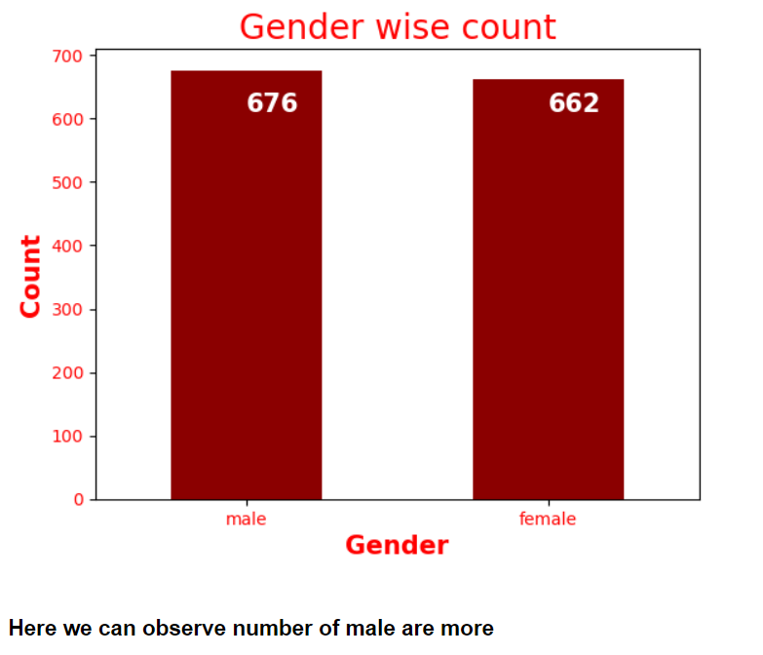
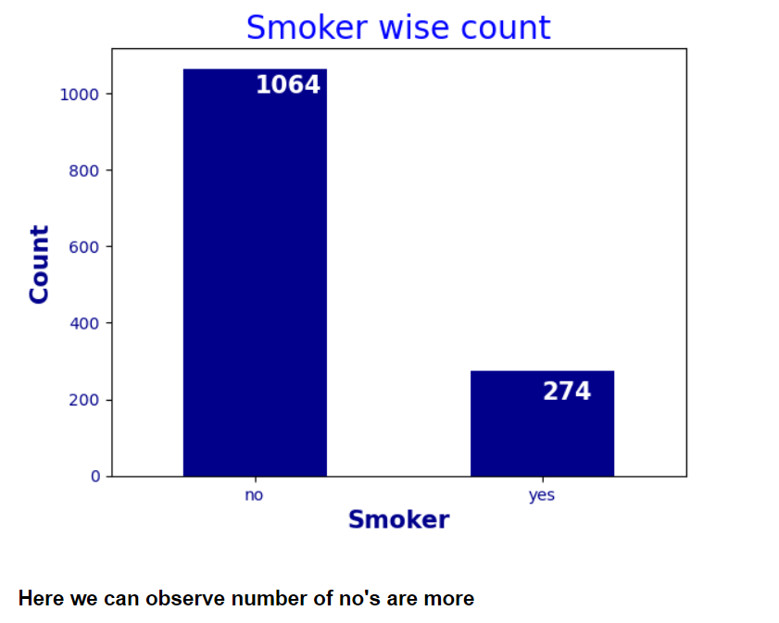
Univariate Analysis :

Slide 9
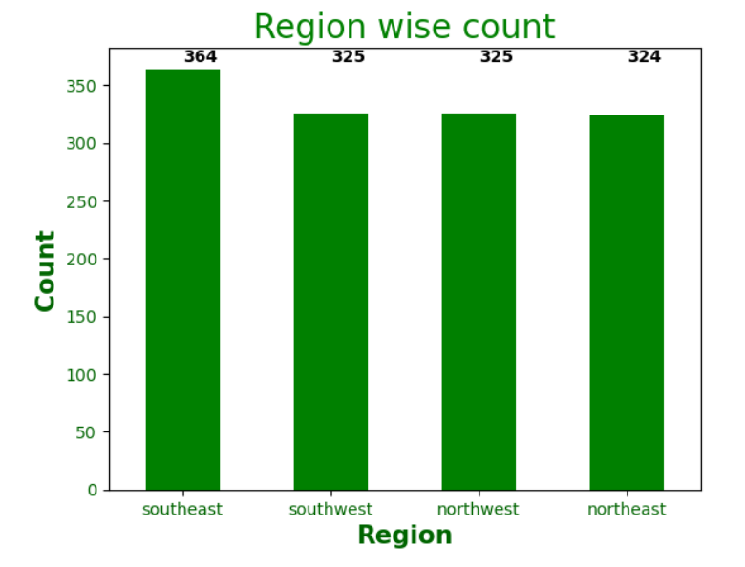
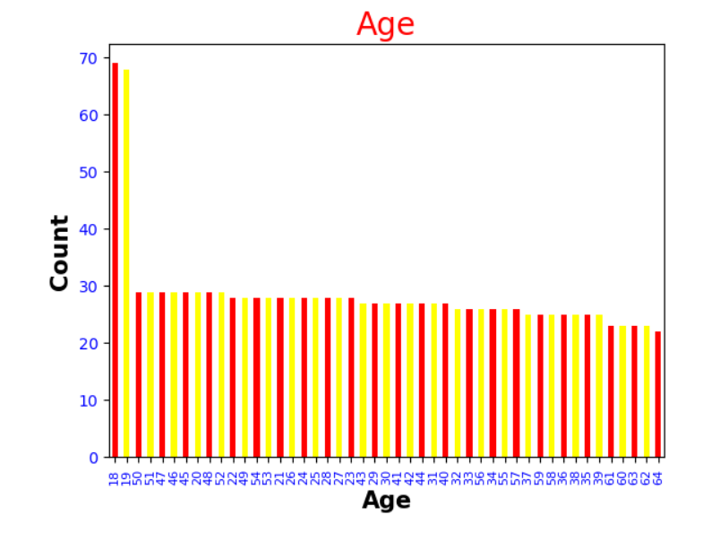

Slide 10
Observations of univariate Analysis :
1. In gender column number of male are more.
2. number of non-smokers is more .
3. people are more from southeast.
4.In age : count=1338 5.Bmi : max=53.13
max=64 min=15.96
min=18
6.Charges : max=63770.42 7.Region : southeast 364
min=1121.8 southwest 325
northwest 325
northeast 324

Slide 11
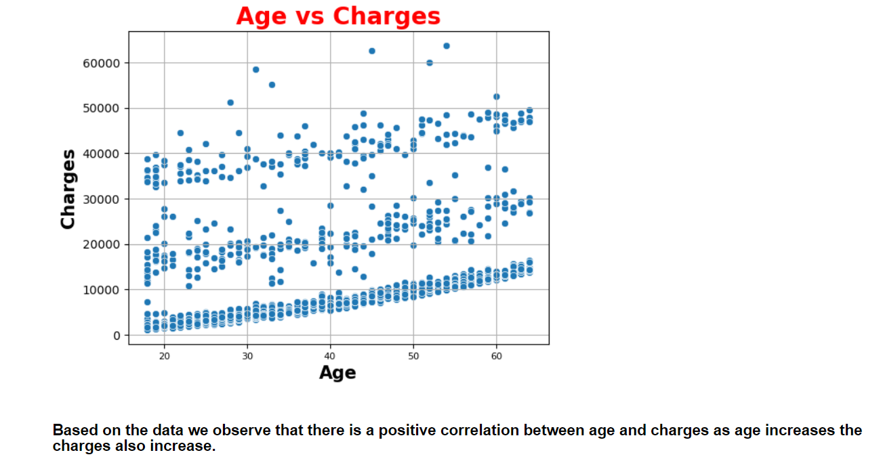
Bivariate Analysis :

Slide 12
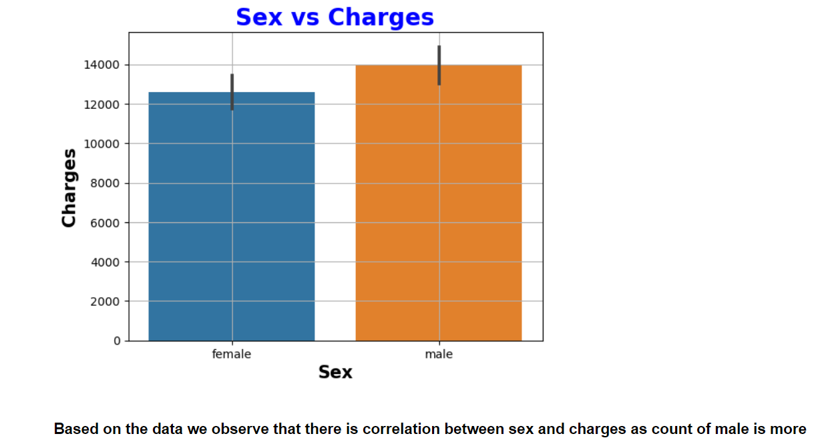

Slide 13
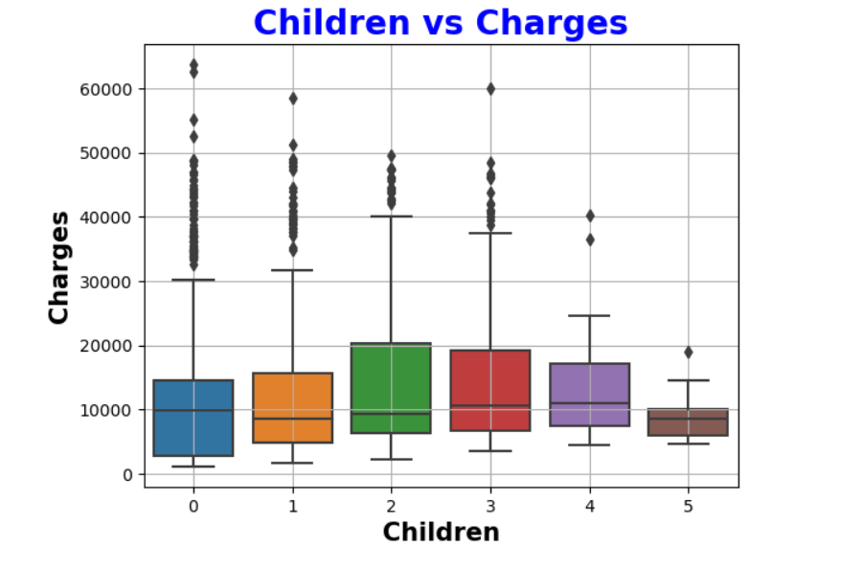
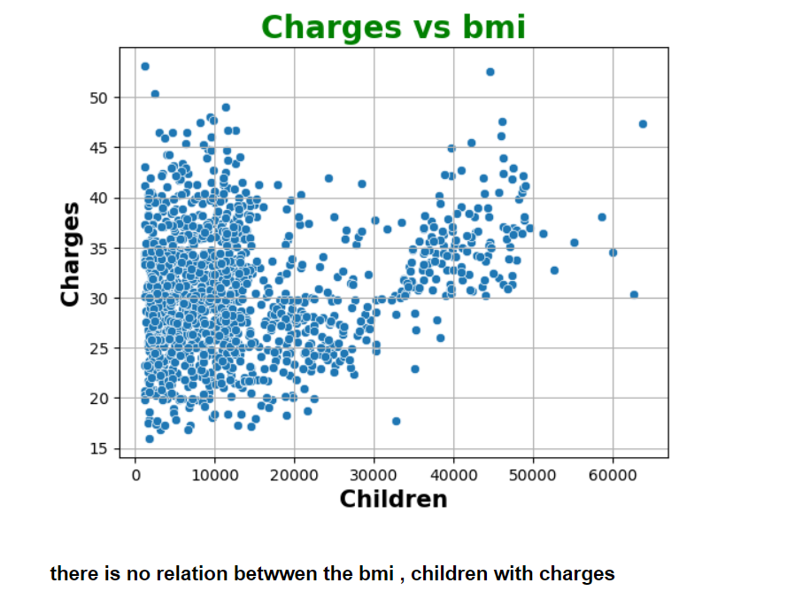

Slide 14
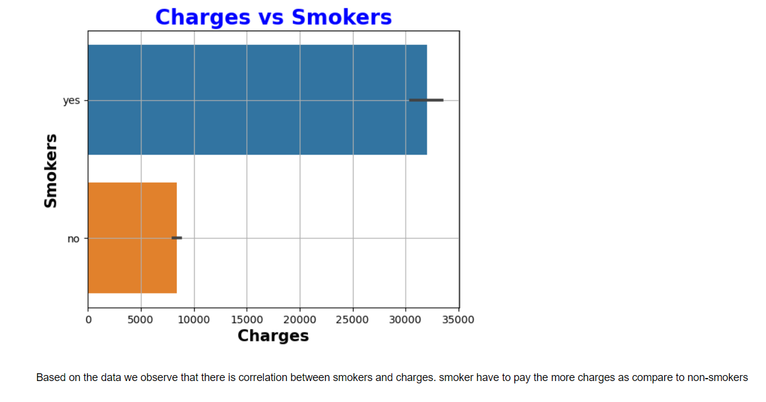

Slide 15
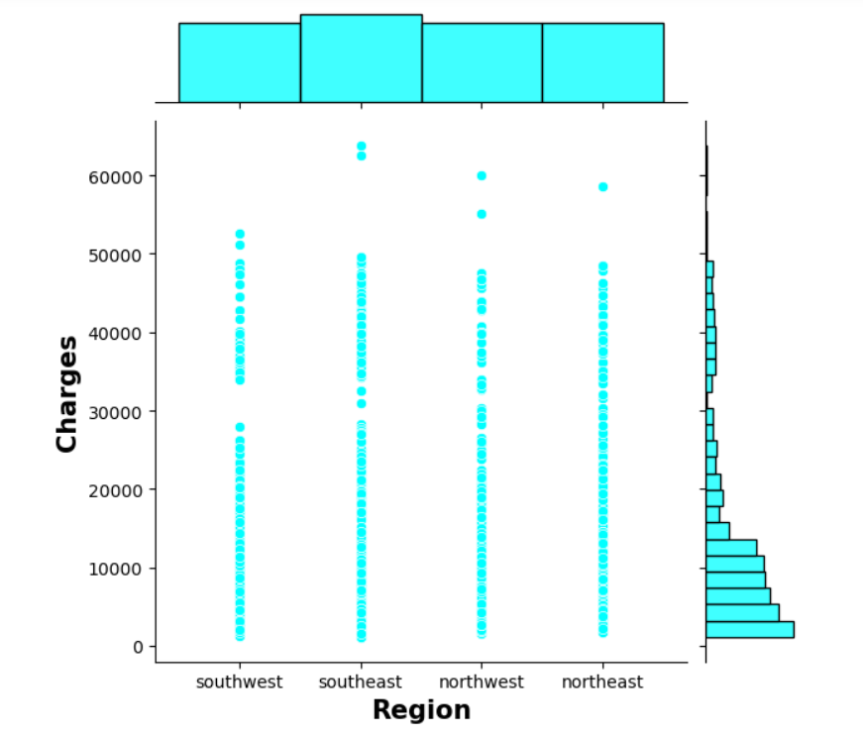

Slide 16
Observation of Bivariate Analysis :
1.There is a positive correlation between age and charges as age increases the charges also increase.
2.Count of male is more as per insurance charges
3.Based on the data we observe that there is correlation between smokers and charges. smoker have to pay the more charges as compare to non-smokers

Slide 17
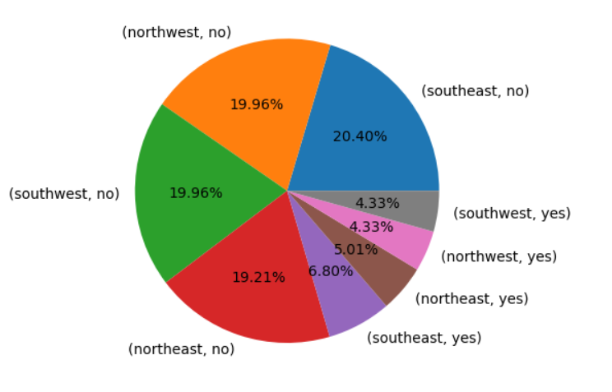
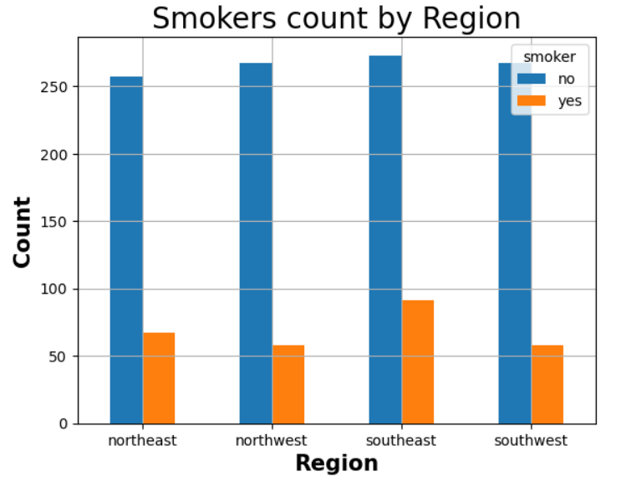
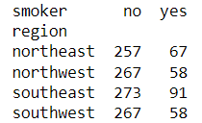
Multi-variate analysis :

Slide 18
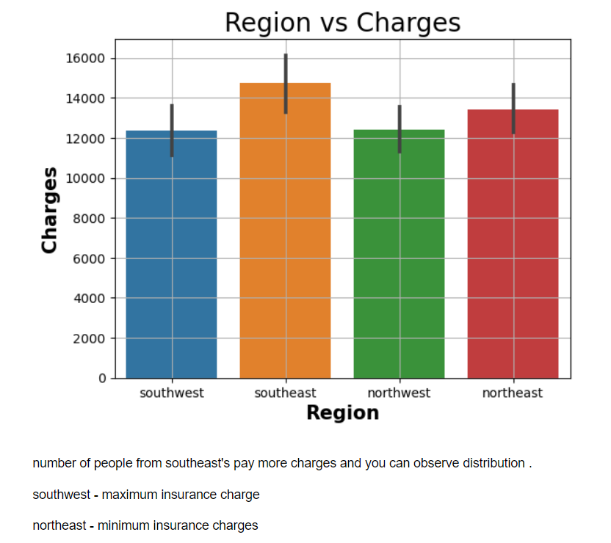

Slide 19
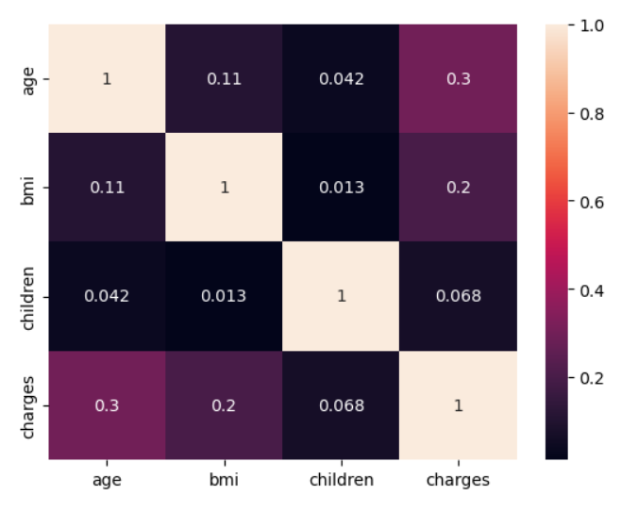
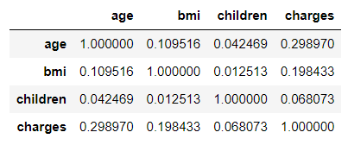
Heatmap :

Slide 20
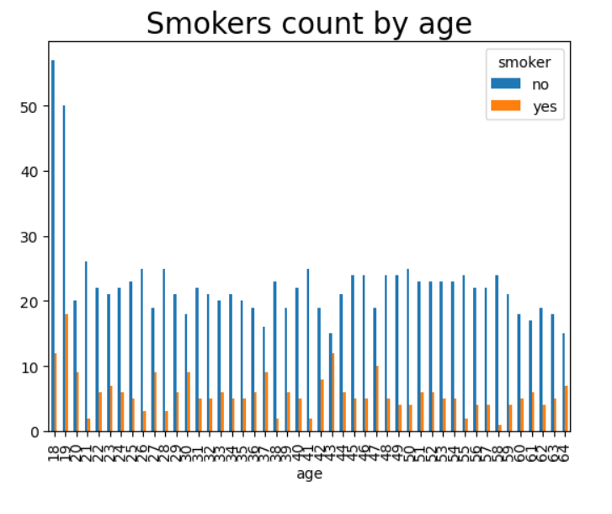

Slide 21
Obesrvations on Mutivariate Analysis
1.It show that southeast people smoke more .
2.number of people from southeast's pay more charges and you can observe distribution .
3.southwest - maximum insurance charge
4.northeast - minimum insurance charges
5.teenagers smoke more and large number of non-smokers also belong to teenagers.

Slide 22
Conclusion
Regional Disparities:
Smoking rates are notably higher among individuals from the southeast region.
The southeast region also exhibits a higher distribution of insurance charges, indicating potential regional variations in healthcare costs and risk factors.

Slide 23
Teenagers are identified as a group with higher smoking rates, and a significant number of non-smokers also fall within this age category.
The dataset comprises a higher count of males, and there is a positive correlation between age and insurance charges, suggesting that older individuals tend to have higher healthcare costs.
The southwest region experiences the highest insurance charges, while the northeast has the lowest.
These regional differences may be influenced by various factors, including healthcare infrastructure, social and economic conditions, and lifestyle choices.

Slide 24
Future Scope
According to information we have to aimed at promoting healthy lifestyle , behaviors and preventing smoking-related health issues.
May introduce fitness awareness camps.

